Slide 1


Global air pollution modelling
University of Utrecht, The Netherlands
Global Geo Health Data Center
Meng Lu

Slide 2
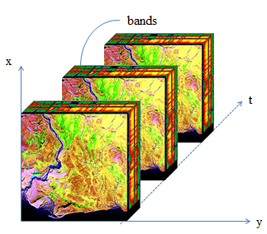
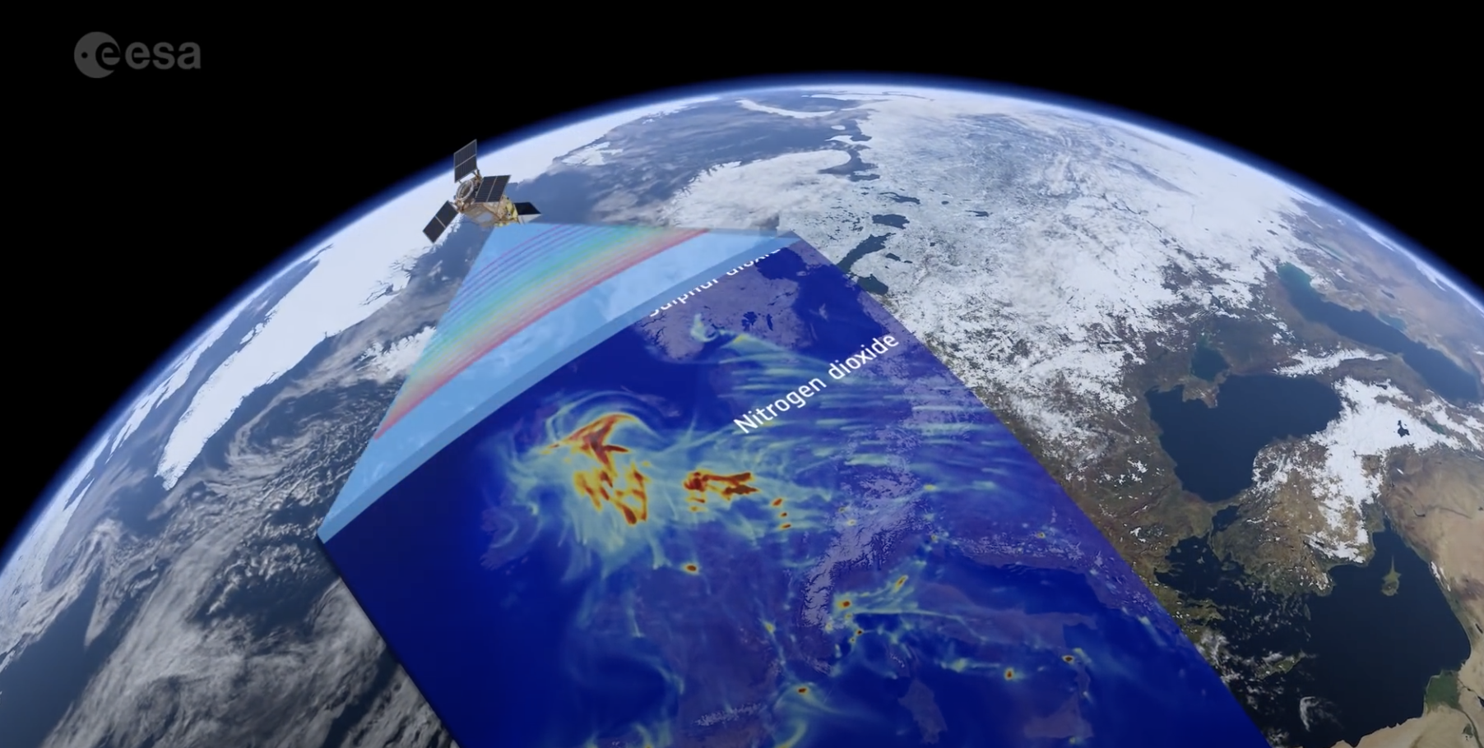
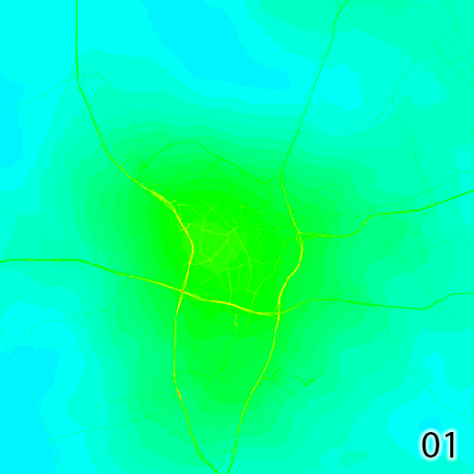
My background
Remote sensing and information engineering
Spatiotemporal change modelling from multidimensional arrays
Spatiotemporal data analysis
Remote sensing
Image analysis
Exposure assessment
Agent-based modeling
Mapping

Slide 3

Goal: Global, high spatiotemporal resolution NO₂ mapping NO₂: is part of a group of gaseous air pollutants produced as a result of road traffic and other fossil fuel combustion processes.

Slide 4
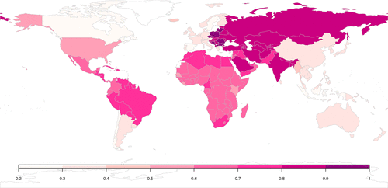
Why global?
Estimation of global burden of disease
to monitor the UN established Sustainable Development Goals
Consistent epidemiological studies world-wide
Inequality in health and air pollution monitors in middle and low income countries
Shaddock et al., 2018

Slide 5

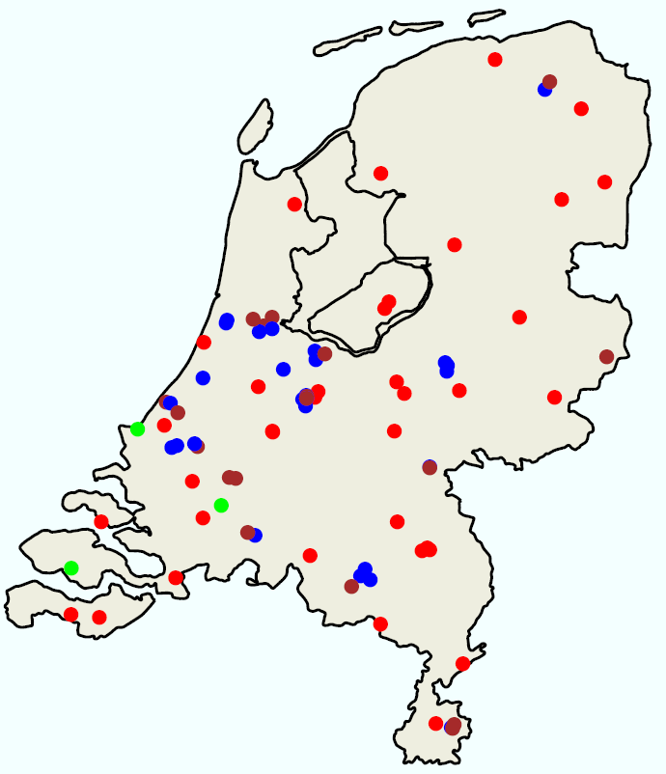
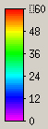
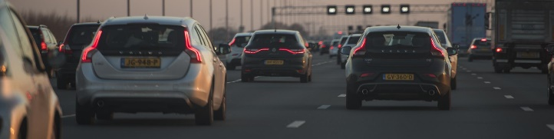
Why high spatial and temporal resolutions?
60
30
RURAL
TRAFFIC
INDUSTRY
Hourly/minutes
LML data (landelijk meetnet luchtkwaliteit)
0
Hour
0
5km

Slide 6
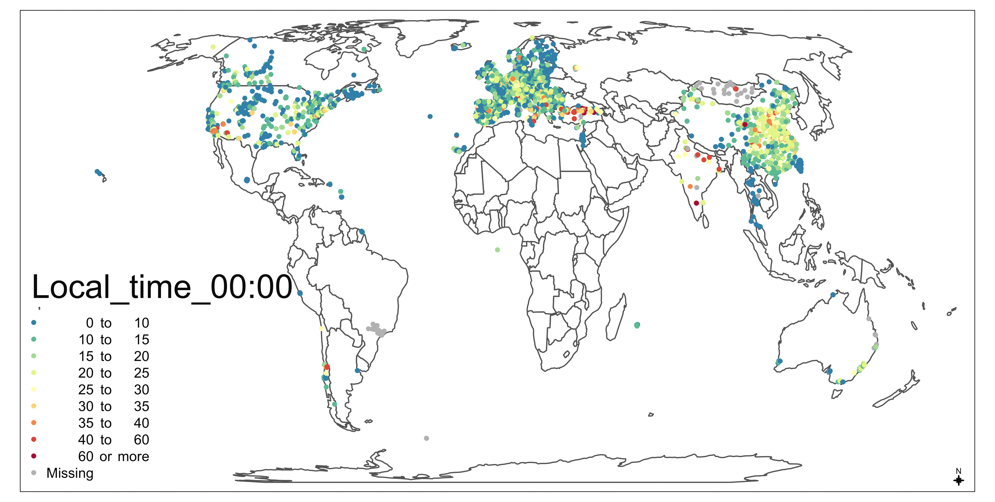
Air pollution modelling methods
Process-based models:
Air dispersion models
Chemical transportation models
Statistical-based methods:
Information form predictors, spatiotemporal dependence.
Station measurements
Predictors

Slide 7

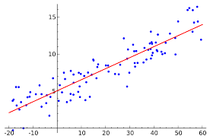



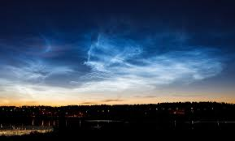
Machine learning vs. Linear regression models
Global models Vs. National models
Daytimg models Vs. Nighttime models
Lu, M. Schmitz, O., Van de Hoogh, K., Qin, K., & Karssenberg, D. Evaluation of different methods and data sources to optimise modelling of NO2 at a global scale. Environmental international

Slide 8
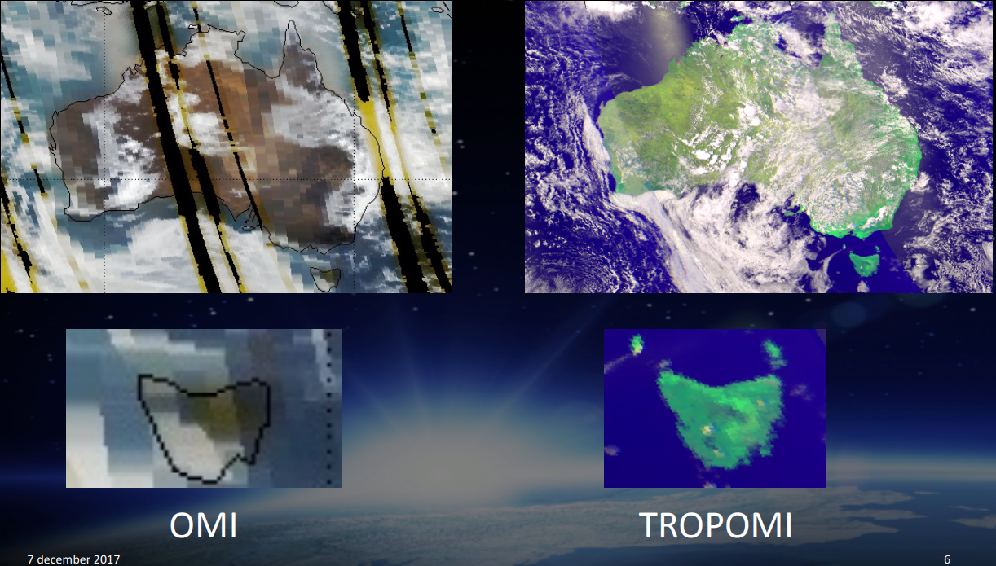
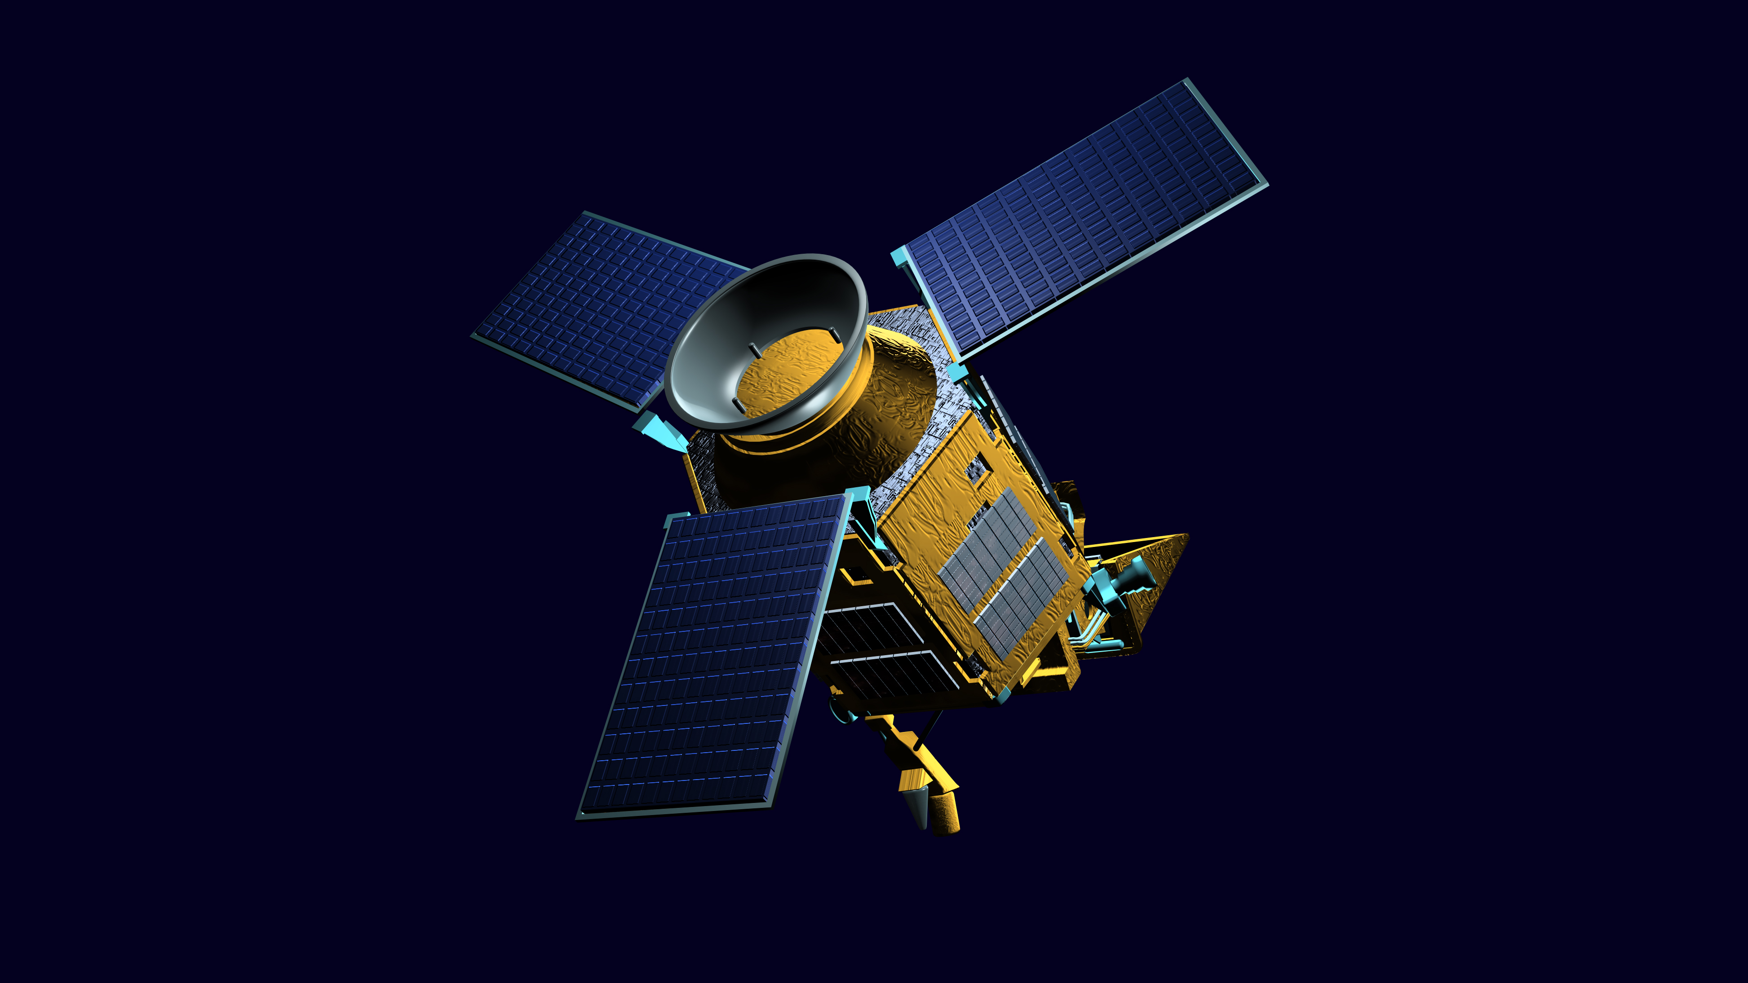
Tropomi: Sentinel 5p
(TROPOspheric Monitoring Instrument)
Launched Oct. 2017,
Resolution (NO2)
2018-2019: 7 km
Since Oct. 2019: 5.5 km
Measurements: NO₂, O₃ (7km × 28km), SO₂, methane and CO
Souce [3]

Slide 9
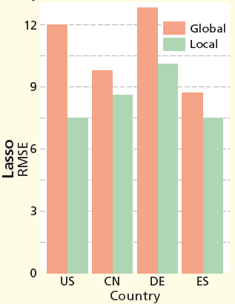
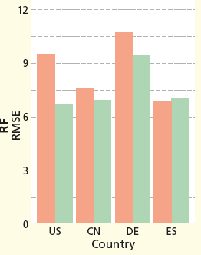
Global Vs. National models
Random Forest
Lasso
RF: random forest
CN: China
DE: Germany
ES: Spain

Slide 10
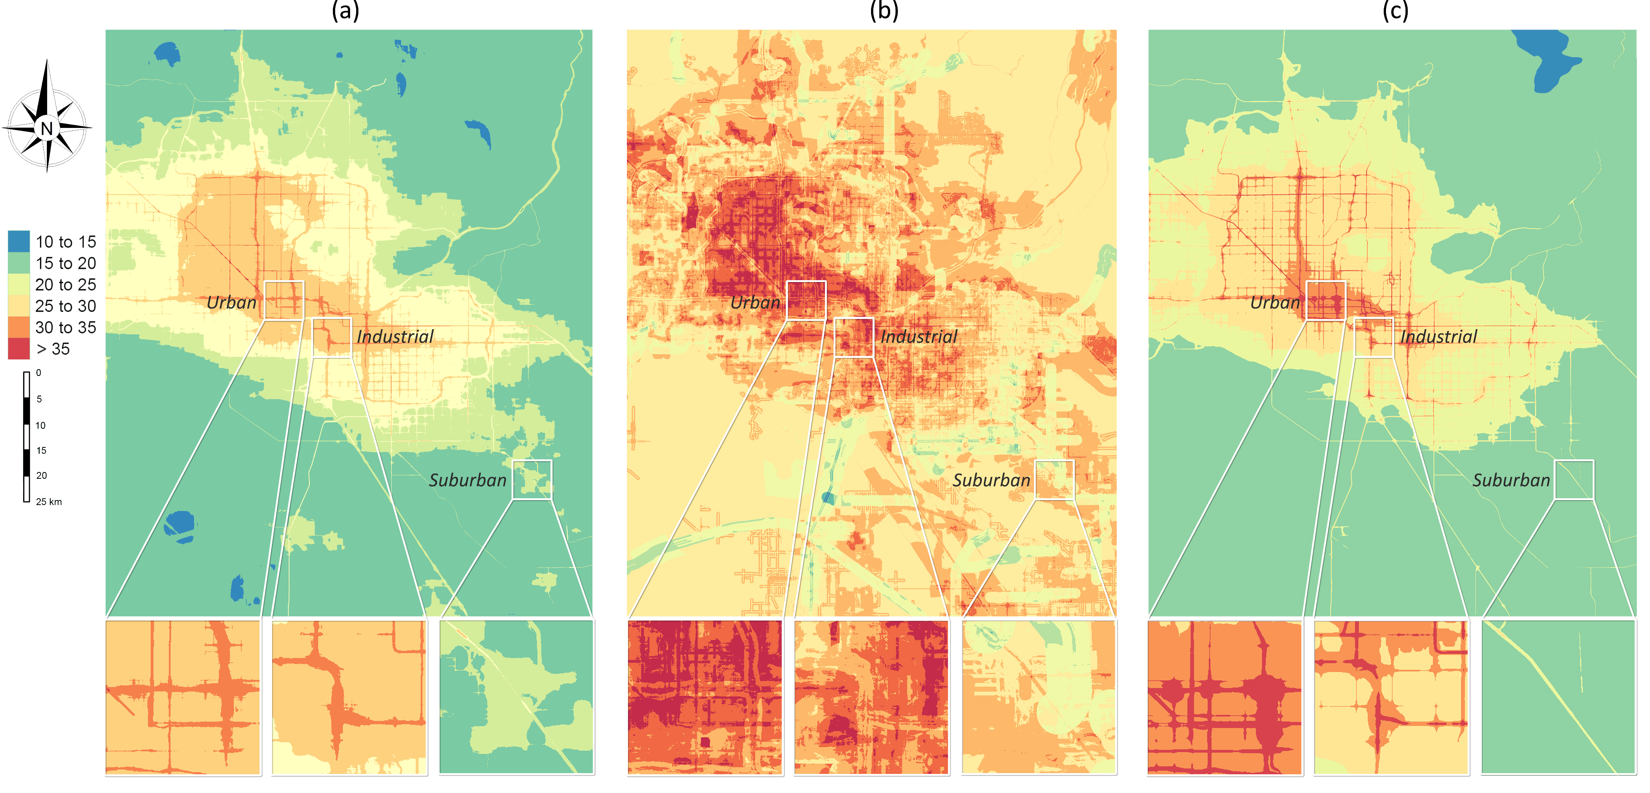
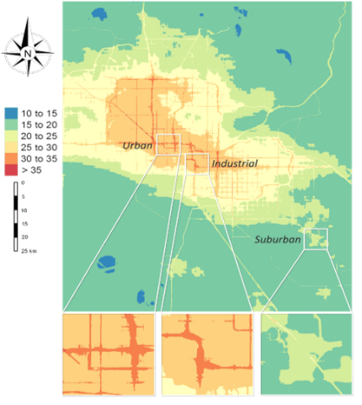


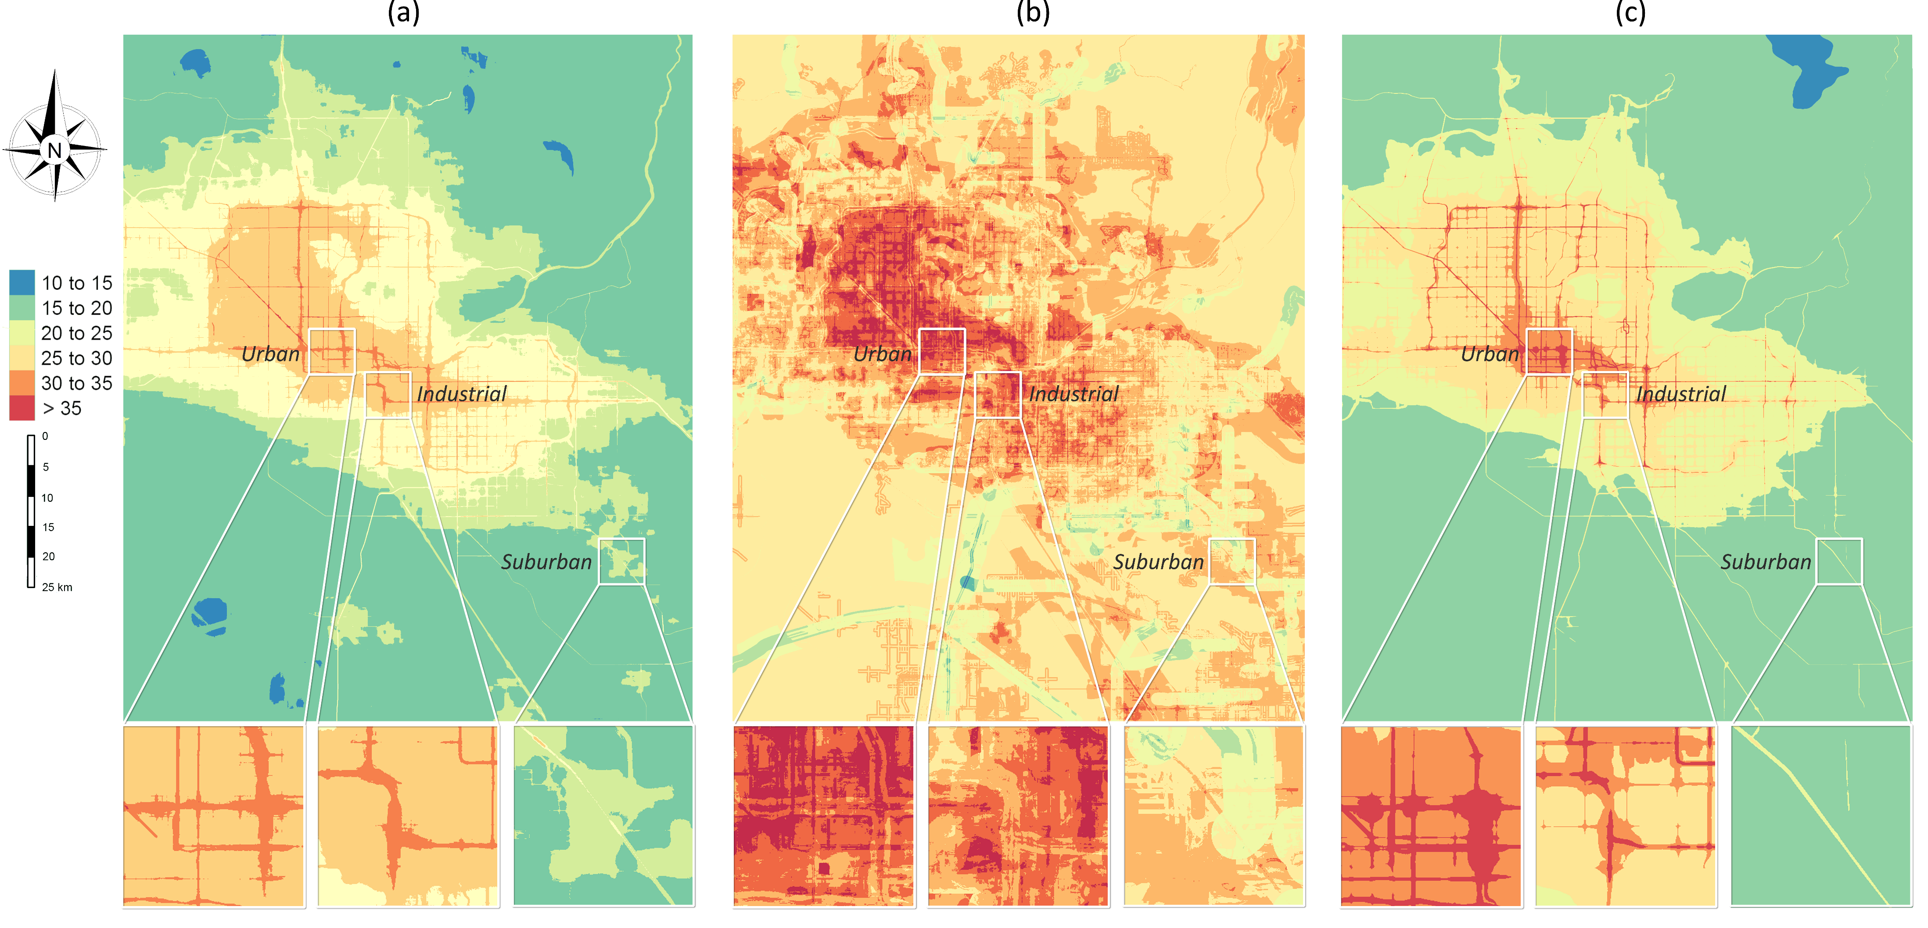

Random Forest
LASSO
NO₂ (µg/$m^{3})$
Phoenix area, Arizona, USA

Slide 11
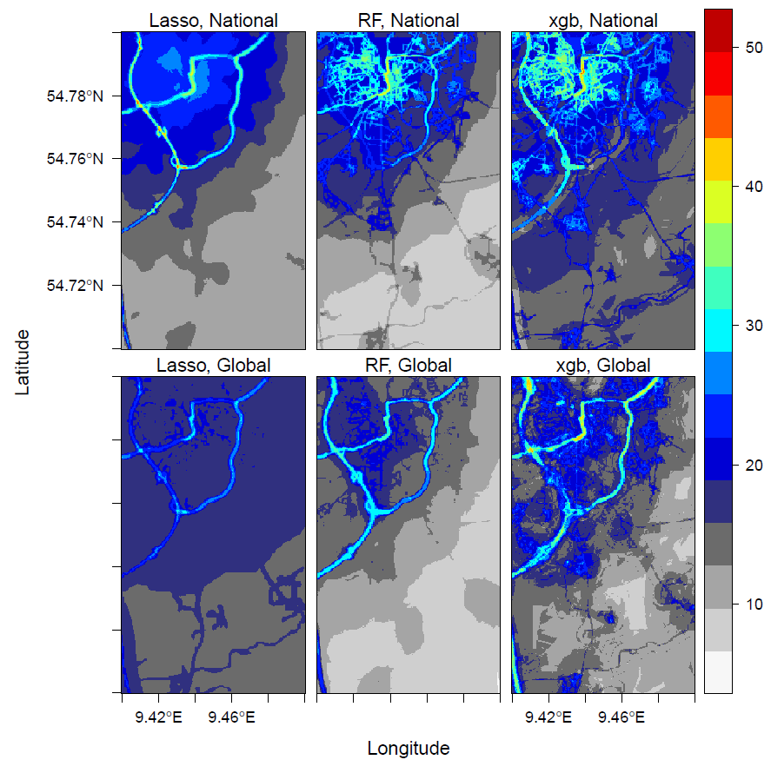
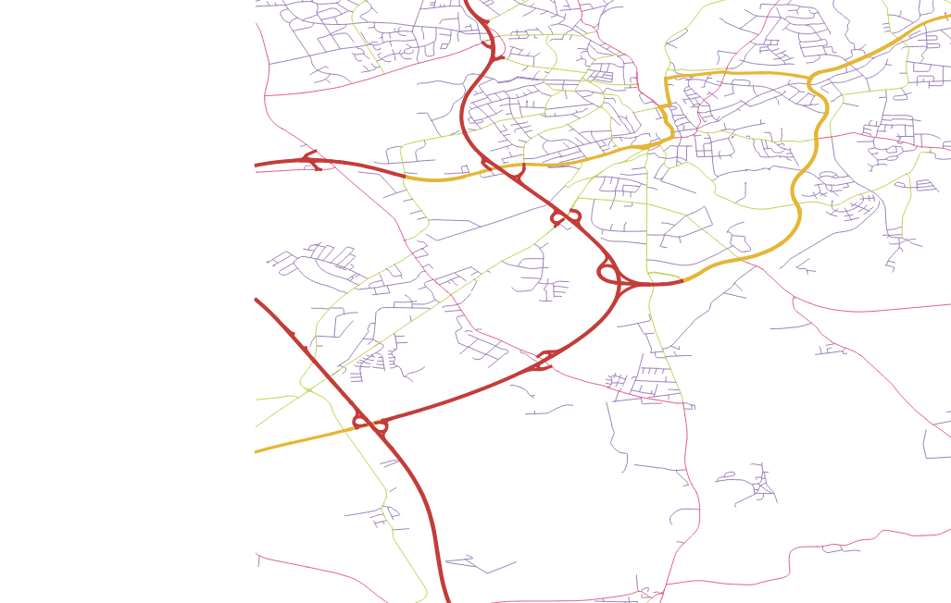
Prediction Patterns
highway
primary
Germany

Slide 12
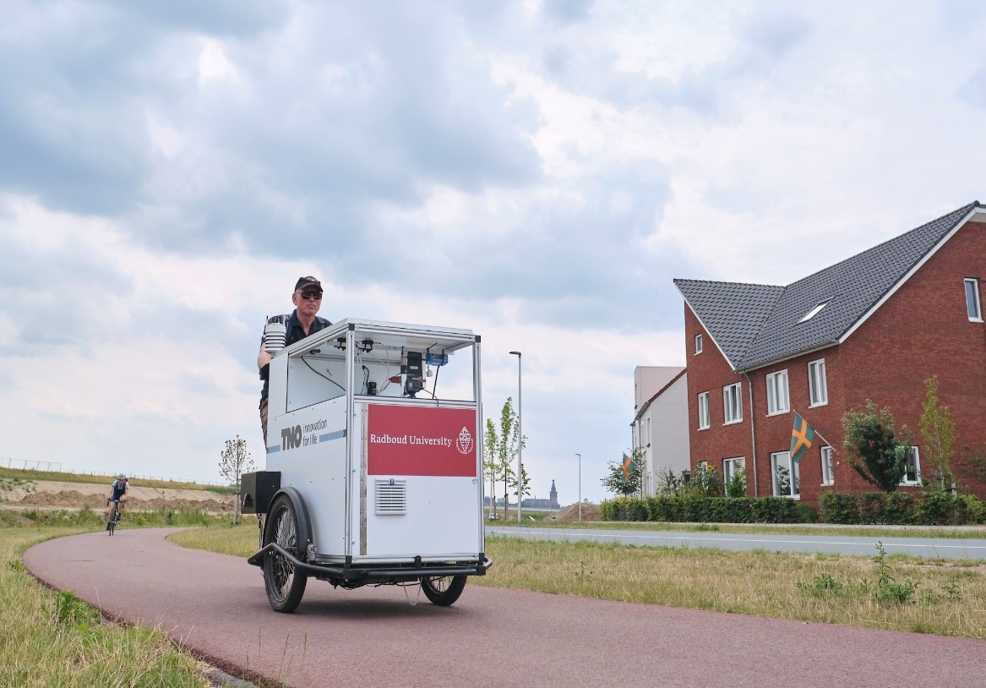
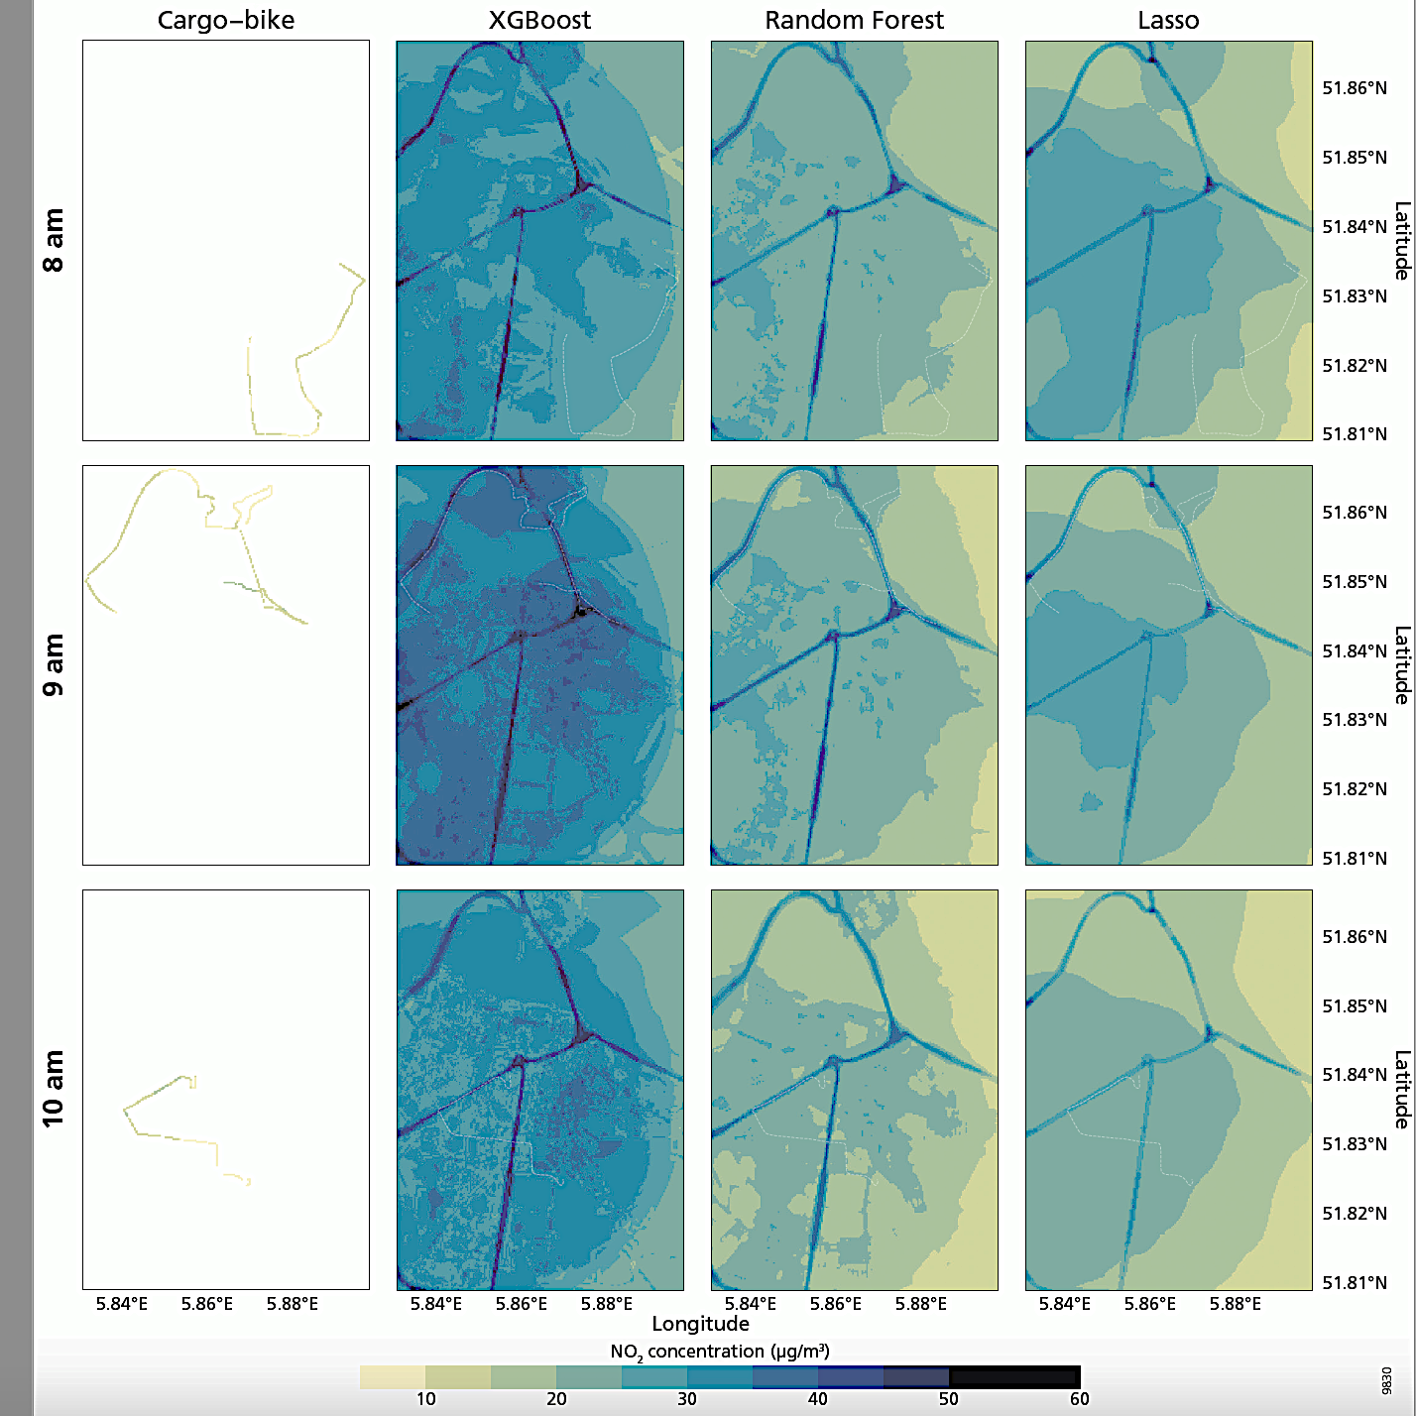
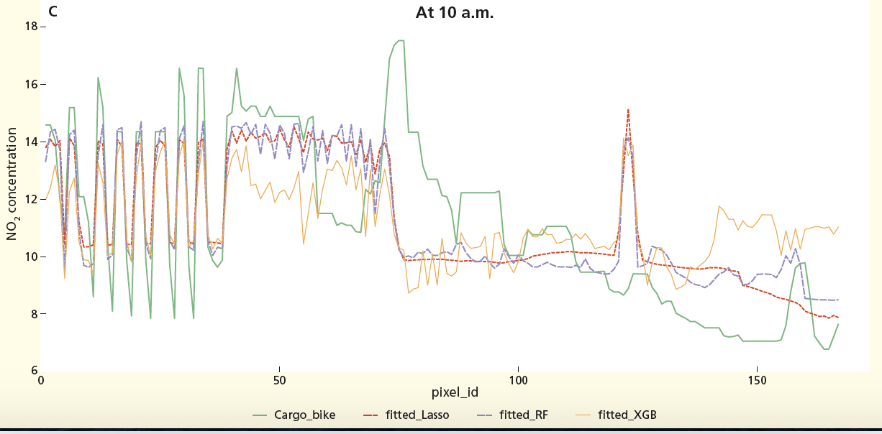
Further validation: cargo-bike measurements

Slide 13
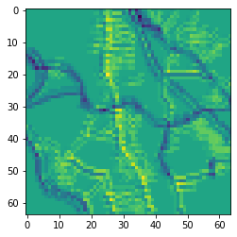
Statistiacal challenges in global-scale spatiotemporal regression
Challenges
Spatially heterogeneous predictor-response relationships
Spatiotemporal variability
Integrate more spatial information
On-going
Temporally-resolved and hierarchical modelling:
Mixed-effect models and deep convolutional neural networls
Road density
Road structure

Slide 14

In the workshop
1. Introduction and data (10%)
2. Statistical modelling techniques (70%)
3. Modelling process in practice (20%)
Querying and processing OpenStreetMap,
hyperparameter tuning,
cross-validation, mapping, model comparison
Start:
Ensemble tree-based ML
Deal with overfitting:
Regularization
Post-processing
More spatial information:
Deep convolutional NN

Slide 15
Thank you
https://github.com/mengluchu/OpenGeoHub2020

Slide 16
1. Introduction to global air pollution mapping, challenges and data exploration hands-on (10 mins): “getting ready” install packages, visualize data, data exploration: e.g. paired correlations, spatial dependence 2. Machine learning methods hands-on + break (30 mins): “machine learning methods.” ensemble trees, regularization and postprocessing, mixed-effect models, convolutional neural networks 3. Modelling process
hands-on (10 mins): “modelling process” hyper-paramter optimization, bootstrapping-based cross-validation, mapping and compare spatial patterns of different predictions 4. Deep convolution neural networks
This part is based on Python, I will share a Kaggle notebook for this. Another option is Anaconda environment, but is less convenient.

Slide 17
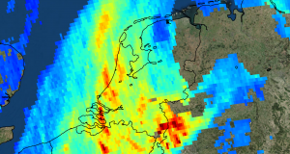
Tropomi
NO₂, O₃ (7km × 28km), SO₂, methane and CO
Electromagnetic field:
ultraviolet and visible (270–500 nm), near-infrared (675–775 nm), shortwave infrared (2305–2385 nm).
zoom in mode: 7 km × 3.5 km
5.5 km x 3.5 km since 2019

Slide 18
Geospatial predictors
Road and industrial area from OpenStreetMap (vector)
Earth nightlight (500 m)
as a proxy for socio-demographics
Population (100 m)
From human settlement layers
Wind speed and temperature
Elevation: SRTM (90 m)

Slide 19
Ground monitor measurements:
OpenAQ: an open science air quality community
Through collaboration: China, Australia, Canada, US, EU

Slide 20
In the workshop
Air pollution mapping:
more details about problems in global prediction and data
Statistical techniques:
Start:
Ensemble and boosting trees → Regularization (ElasticNet, XGboost)
Tackle more of the challenges:
- Improvement of modelling process: Post-processing
Aggregating trees using regularized regression
- Hierarchical models:
Mixed-effect models, (Deep) convolutional NN (as in computer vision)
Comparison and relationships between techniques
Modelling process in practice:
Querying and processing OpenStreetMap, data wrangling, hyperparameter tuning, cross-validation, mapping

